Slide 1


Slide 2
Software Planning

Slide 3

Size of project
Cost of project
Work break down structure
Critical path method

Slide 4
Typical Size-Oriented Metrics
errors per KLOC (thousand lines of code)
defects per KLOC
$ per LOC
page of documentation per KLOC
errors / person-month
LOC per person-month
$ / page of documentation

Slide 5
Create three-point or expected value estimate
Optimistic values for size
Most likely values for size
Pessimistic values for size
S=(s_{opt}+4s_{m}+s_{pess})/6
Where S = the expected value for the estimation variable(size)

Slide 6
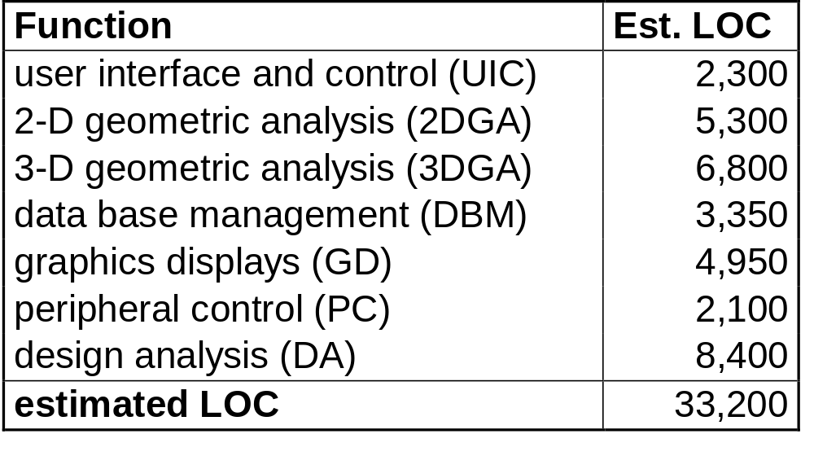
Example of LOC-Based Estimation

Slide 7
Range of LOC estimates for the 3D geometric analysis function is optimistic-4600 LOC, most likely-6900 LOC, and pessimistic-8600 LOC

Slide 8
Organizational average productivity=620 LOC/pm
Labor rate = $8000 per month
Estimated effort = ?
Total Estimated Effort = LOC est. / prod.
Cost/LOC = ?
Cost / LOC = labor rate / prod.
Total cost = ?
Total Project Cost = LOC est. * (cost / LOC)

Slide 9
Optimistic values | Most likely | Pessimistic values | Est. LOC
23 | 24 | 30 | 24.8
50 | 54 | 59 | 54.17
101 | 105 | 108 | 104.83
 |  | Total LOC | 183.8

Slide 10

Function-Oriented Metrics
Uses a measure of the functionality
  – inputs, outputs, files, inquiries, Interfaces
Indirectly derived
Function point
  scaled by simple, average, complex

Slide 11
Typical Function-Oriented Metrics
errors per FP (thousand lines of code)
defects per FP
$ per FP
pages of documentation per FP
FP per person-month

Slide 12
Computing Function Points
Analyze information
domain of the
Establish
count
for input domain and
application
system interfaces
and develop counts
Weight each count by
Assign level of complexity or
weight
assessing complexity
to each count
Assess influence of
Grade significance of external factors, F
global factors that affect
i
such as reuse, concurrency, OS, ...
the application
Compute
function points
FP = Count Total * [ 0.65 + 0.01 * (Fi)]

Slide 13
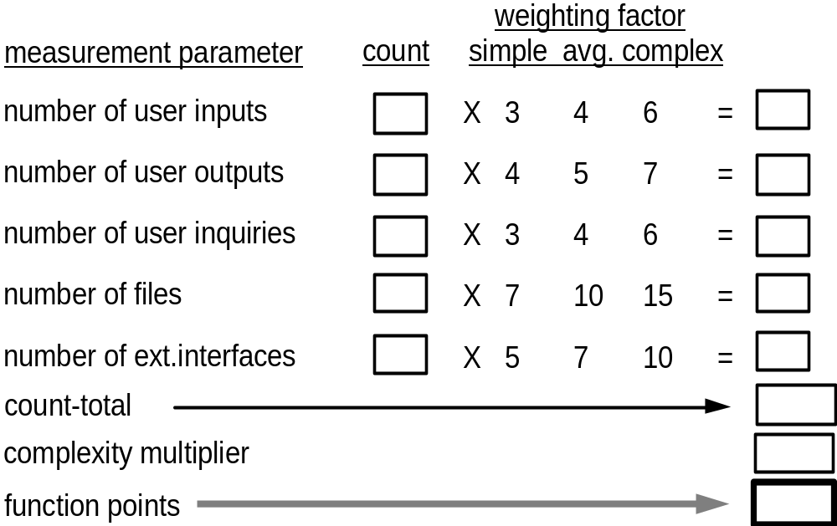
Analyzing the Information Domain

Slide 14
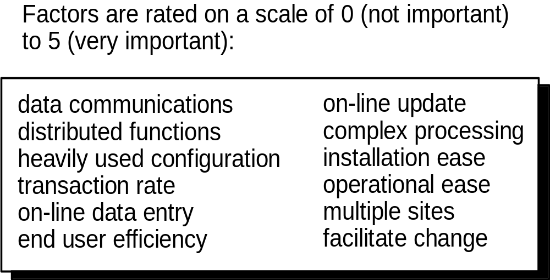
Taking Complexity into Account

Slide 15
Apply the following formula
  Fp_{estimated}=count-total*[0.65+0.01* Σ(Fj)]

Slide 16
Example of FP-Based Estimation
Information domain value
Optimistic
Most Likely
Pessimistic
Number of inputs
20
24
30
Number of outputs
12
15
22
Number of inquiries
16
22
28
Number of files
4
4
5
Number of external interfaces
2
2
3

Slide 18
Information domain value
Estimated count
Weight
FP count
Number of inputs
24
4
97
Number of outputs
16
5
78
Number of inquiries
22
4
88
Number of files
4
10
42
Number of external interfaces
2
7
15

Slide 19
Factor
Value
Backup and recovery
4
Data communication
2
Distributed processing
0
Performance critical
4
Existing operating environment
3
On-line data entry
4
Input transaction over multiple screens
5
Master files updated on-line
3
Information domain values complex
5
Internal processing complex
5
Code designed for reuse
4
Conversion/installation in design
3
Multiple installations
5
Application designed for change
5
Total
52

Slide 20
Fp_{estimated}=count-total*[0.65+0.01* Σ(Fj)]
Fp_{estimated}=372
Organizational average productivity=620 FP/pm
Labor rate = $8000 per month
Estimated effort = ?
Total Estimated Effort = FP est. / prod.
Cost/FP = ?
Cost / FP = labor rate / prod.
Total cost = ?
Total Project Cost = FP est. * (cost / FP)

